Slide 1
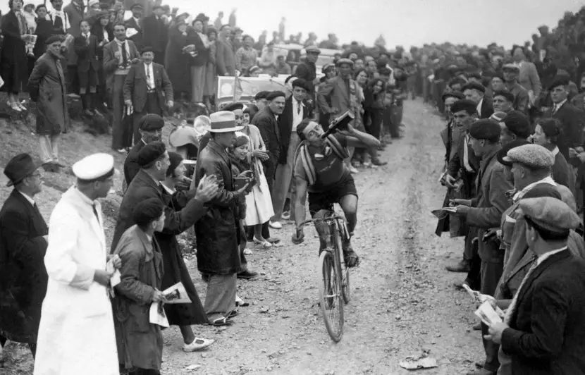
Artificial Intelligence
Alexander, Dennis, Hélène

Slide 2
Objectives
Build various classification models like Support Vector Machines, Random Forests, kNN/logistic regression to make predictions on 3 different datasets
Compare results based on accuracy, balanced accuracy, precision and recall
Compare computation times between models

Slide 3
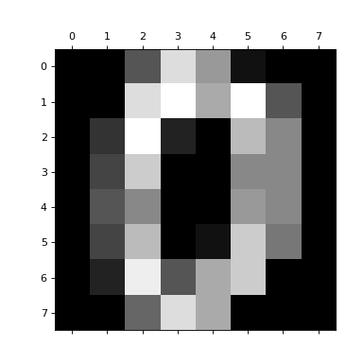
Simplified digits dataset
Dataset designed for the optical recognition of handwritten digits. 30 people contributed to the training set and different 13 to the test set.
32x32 bitmaps divided into non-overlapping blocks of 4x4 and the number of pixels are counted in each block. This generates an input matrix of 8x8 where each element is an integer in the range 0..16.
Reduced dimensionality and more invariance to small distortions.
Preprocessing: data standardization
Classes | 10
Samples per class | ~180
Samples total | 1797
Dimensionality | 64
Features | Integers from 0 to 16

Slide 4
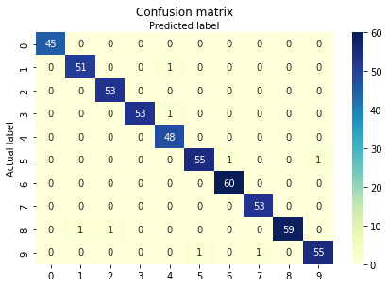
Simplified digits dataset - Support Vector Machines
Implementation is based on libsvm, it is non-linear and the fit time scales at least quadratically with the number of samples
Grid search to find best params:
kernel='rbf'
exp⁡(−γ‖x−x′‖2), where γ is specified by parameter gamma
gamma= 0.01 Kernel coefficient
C= 10
With 5-fold CV on test: Accuracy: 0.985 Balanced accuracy: 0.986

Slide 5
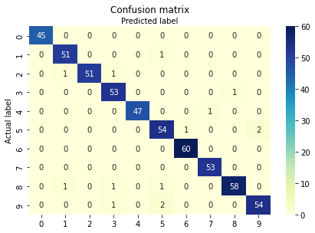
Simplified digits dataset - Random Forest Classifier
A random forest is a meta estimator that fits a number of decision tree classifiers on various sub-samples of the dataset and uses averaging to improve the predictive accuracy and control over-fitting
Grid search to find best params:
criterion='entropy’ or function to measure the quality of a split Instead of utilizing simple probabilities, this method takes the log base2 of the probabilities
max_depth=8 max depth of a tree
max_features='auto' number of features to consider when looking for the best split
n_estimators = 500 number of trees in the forest
With 5-fold CV on test: Accuracy: 0.974 Balanced accuracy: 0.975

Slide 6
Pima Indians Diabetes Dataset
Pima Indians Diabetes Database
Predict the onset of diabetes based on diagnostic measures
https://www.kaggle.com/uciml/pima-indians-diabetes-database
This dataset is originally from the National Institute of Diabetes and Digestive and Kidney Diseases. The objective of the dataset is to diagnostically predict whether or not a patient has diabetes, based on certain diagnostic measurements included in the dataset.
N samples: 768
No null values

Slide 7
Pima Indians Diabetes Dataset
Feature | Description
Pregnancies | Number of times pregnant
Glucose | Plasma glucose concentration a 2 hours in an oral glucose tolerance test
BloodPressure | Diastolic blood pressure (mm Hg)
SkinThickness | Triceps skin fold thickness (mm)
Insulin | 2-Hour serum insulin (mu U/ml)
BMI | Body mass index (weight in kg/(height in m)^2)
DiabetesPedigreeFunction | Diabetes pedigree function
Age | Age (years)

Slide 8
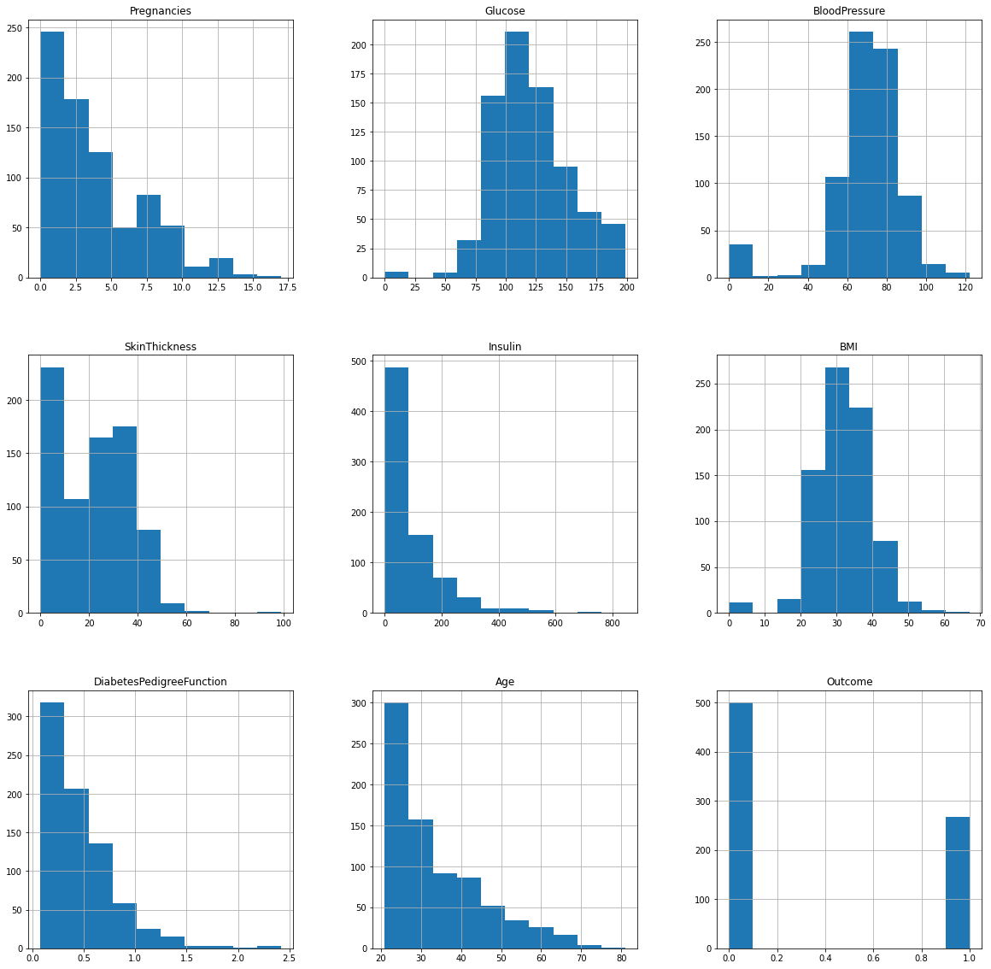
Pima Indians Diabetes Dataset

Slide 9
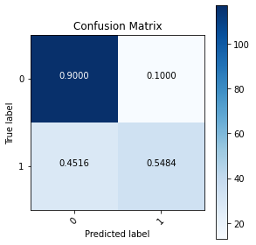
Pima Indians Diabetes Dataset
Logistic Regression
Best Params: 'penalty': 'L2' (Ridge), 'C': 1.0
Logistic Regression
Accuracy: 0.786
Precision: 0.723
Recall: 0.548
Balanced accuracy: 0.724

Slide 10

Pima Indians Diabetes Dataset
Support Vector Machine
Best Params: 'kernel': 'rbf' (Radial basis function), 'gamma': 0.01, 'C': 1
Support Vector Machine
Accuracy: 0.792
Precision: 0.729
Recall: 0.565
Balanced accuracy: 0.732

Slide 11
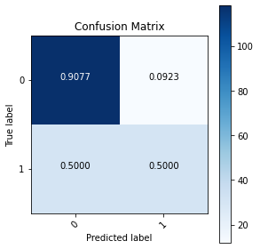
Pima Indians Diabetes Dataset
Random Forests
Best Params: 'n_estimators': 200, 'max_features': sqrt, 'max_depth': 4'
Random Forests
Accuracy: 0.776
Precision: 0.721
Recall: 0.5
Balanced accuracy: 0.704

Slide 12
Pima Indians Diabetes Dataset
Using 5-fold cross validation:
Model | Train Accuracy (%) | Test Accuracy (%) | Training time (ms)
Logistic Regression | 77.44 ± 0.60 | 77.09 ± 1.63 | 3.902 ± 0.208
Support Vector Machine | 77.67 ± 0.67 | 77.09 ± 1.83 | 11.111 ± 0.863
Random Forests | 82.75 ± 1.15 | 75.66 ± 3.51 | 711.87 ± 13.721

Slide 13
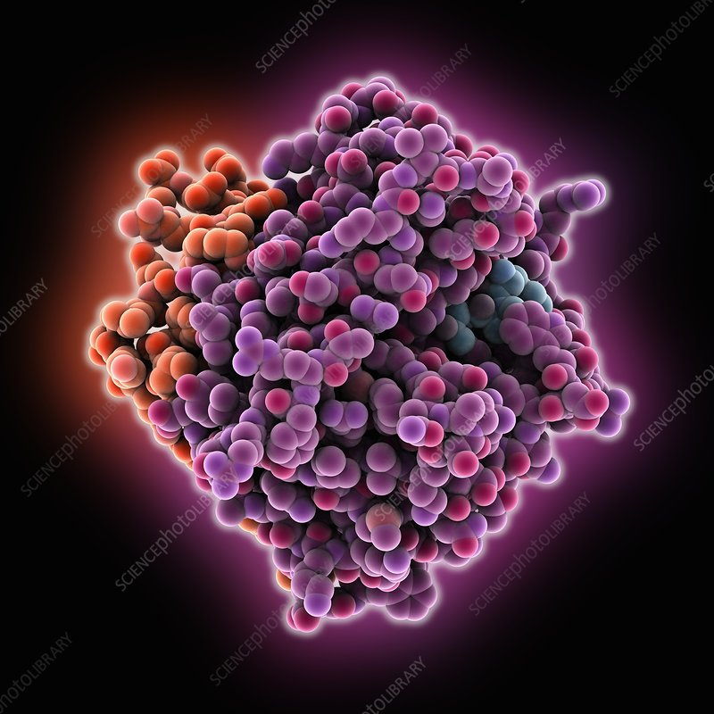
Prediction of Molecular Bioactivity for Drug Design -- Binding to Thrombin dataset
Training dataset → 1908 rows each representing a compound that might bind to Thrombin
Each row → 139,351 binary features, which describe three-dimensional properties of the molecule
Target class → “activity”
A = active = compound may bind
I = inactive = compound can not bind
Completely unbalanced!
I - 1866
A - 42

Slide 14
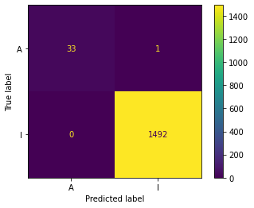
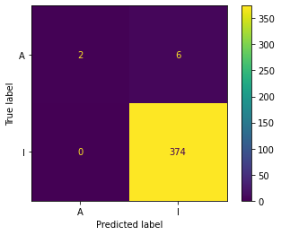
Prediction of Molecular Bioactivity for Drug Design -- Binding to Thrombin dataset
Metrics for training set with Logistic Regression
Accuracy: 0.999
Precision: 1.0
Recall: 0.971
Balanced accuracy: 0.985
Metrics for test set with Logistic Regression
Accuracy: 0.984
Precision: 1.0
Recall: 0.25
Balanced accuracy: 0.625

Slide 15
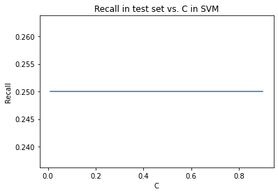
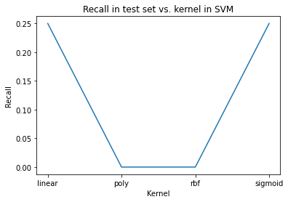
Prediction of Molecular Bioactivity for Drug Design -- Binding to Thrombin dataset
Metrics for training set with SVM
Accuracy: 0.999
Precision: 1.0
Recall: 0.971
Balanced accuracy: 0.985
Metrics for test set with SVM
Accuracy: 0.984
Precision: 1.0
Recall: 0.25
Balanced accuracy: 0.625

Slide 16
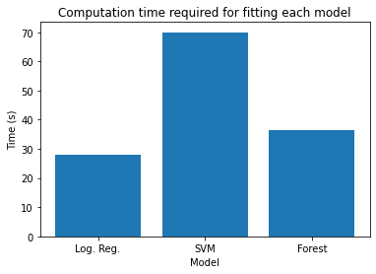
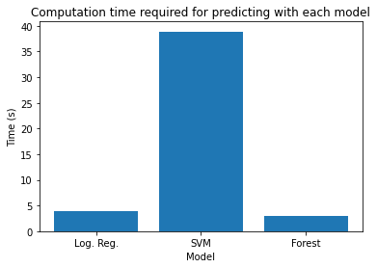
Prediction of Molecular Bioactivity for Drug Design -- Binding to Thrombin dataset
Metrics for training set with Random forest with 10,000 trees
Accuracy: 0.999
Precision: 1.0
Recall: 0.971
Balanced accuracy: 0.985
Metrics for test set with Random forest with 10,000 trees
Accuracy: 0.984
Precision: 1.0
Recall: 0.25
Balanced accuracy: 0.625

Slide 17
Scores recap
 | SVM |  |  | Random forest classifier |  |  | Logistic regression
 | Digits | Pima | Thrombin | Digits | Pima | Thrombin | Digits | Pima | Thrombin
Accuracy | 0.985 | 0.792 | 0.984 | 0.974 | 0.776 | 0.984 | 0.957 | 0.786 | 0.984
Balanced accuracy | 0.986 | 0.732 | 0.625 | 0.975 | 0.704 | 0.625 | 0.959 | 0.724 | 0.625
Precision | Can be computed per digit but not overall | 0.729 | 1.0 |  | 0.721 | 1.0 |  | 0.723 | 1.0
Recall |  | 0.565 | 0.25 |  | 0.50 | 0.25 |  | 0.548 | 0.25

Slide 18
Conclusions
For a very simple problem like the digits one, different models have similar performances
For unbalanced datasets like Binding to Thrombin, all models had similar performances
Computational times for SVM were the highest (non-linear stores support vectors in memory)

